Slide 1
Triangles

Slide 2
What are you doing with triangles…
Click the appropriate box
Find the missing side of a right triangle
(Chapter 11)
Decide if three side lenghts could form a right triangle
(Chapter 11)
Find a missing angle
(7th Grade)
Find the area
(7th Grade)

Slide 3
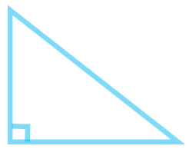
Find the missing side of a right triangle
In order to find the missing side of a right triangle you can use the:
PYTHAGOREAN THEOREM!!
*Remember* a² + b² = c²
a and b are the legs (the two sides that form the right triangle) and c is always the hypotenuse, which is the side opposite the right angle.
Hypotenuse
Leg
See an example of finding a missing leg
See an example of finding the hypotenuse
Leg

Slide 4
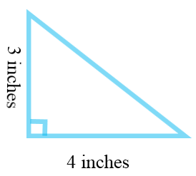
To find the hypotenuse
1) Start by writing down the formula:
2) Plug in the lengths of the legs into a and b.
3) Solve for c.
a² + b² = c²
3² + 4² = c²
9 + 16 = c²
√
25 = c²
√
5 = c

Slide 5
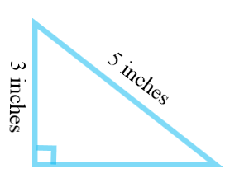
To find the length of a leg
1) Start by writing down the formula:
2) Plug in the length of the leg into a or b, and replace c with the hypotenuse.
a² + b² = c²
3² + b² = 5²
3) Solve for b.
9 + b² = 25
–9 –9
√
b² = 16
√
b = 4

Slide 6
Can 3 sides form a right triangle?
Since the Pythagorean Theorem
a² + b² = c²
Only works for right triangles
Then see if it works.
If it works, then yes, the three sides could form a right triangle.
If not, then no they could no.
*Don’t forget to replace c with the longest side, since if it could form a right triangle, the longest would be the hypotenuse!

Slide 7
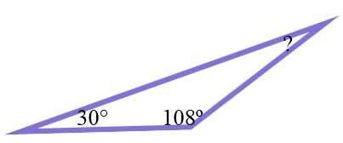
Finding missing angle
The sum of the angles of a triangle are 180°!
Add the angles that you know and subtract this amount from 180.
30 + 108 = 138
180 – 138 = 42°
You can also set up an equation, which can be helpful if you have variables, and then solve.
Ex: 30 + 108 + x = 180

Slide 8
Find the area of a triangle
To find the area of a triangle use the formula:
A = ½ bh
*Don’t forget that base and height always form a right angle!

