Slide 1
Writing rules for functions
Using the ∆y and ∆x method…

Slide 2
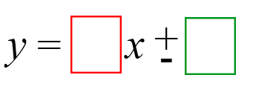
Start with “y = “
All final answers should look like:
Your goal is to find the numbers that go in each of the boxes.
STEP 1

Slide 3
Step 1:
Find ∆x
How much does x change by each time?
∆x =
STEP 2

Slide 4
Step 2:
Find ∆y
How much does y change by each time?
∆y =
STEP 3

Slide 5
Step 3:
Set up a fraction that looks like:
$$\frac{Δy}{Δx}$$
*Reduce the fraction if possible (but do not make a decimal)
STEP 4

Slide 6

Step 4:
Fill in the first box with the number you just got.
$$\frac{Δy}{Δx}$$
STEP 5

Slide 7
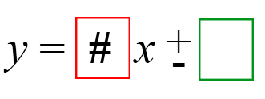
Step 5:
Replace x with the first input value in the table and see if you get the correct output.
IF YES – You are done.
IF NO – Adjust the function by adding or subtracting to get the number you want.
STEP 6

Slide 8
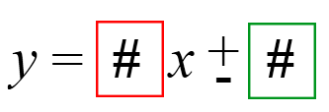
Step 6:
Replace x with each input and make sure you get the correct output every time.
X | # | # | # | #
Y | # | # | # | #

