Slide 1
CHAPTER 8
Simplifying Exponents

Slide 2
1. Are there any parentheses?
Ex: (2x²y)³
YES
NO

Slide 3
Get rid of parenthesis by raising each piece to the power
(2x²y)³
2
x²
y
³
³
³
8x⁶y³
NEXT STEP

Slide 4
Are there any negative exponents?
YES
NO

Slide 5

2. Make any negative exponents positive.
If there are negative exponents, make the exponents positive by moving the item.
If the item is in the numerator, move it to the denominator to make it’s exponent positive.
If the item is in the denominator, move it to the numerator to make it’s exponent positive.
$$\frac{4 y}{3 }$$
$$x^{−3}$$
z³
$$z^{−3}$$
x³
NEXT STEP

Slide 6

3. Simplify numbers by multiplying or reducing.
If any of the pieces have numbers for their base, simplify these numbers by either doing out the power, multiplying, reducing or all.
$$\frac{2^{2}x^{5}y^{3}}{4^{2}x^{2}y^{8}·3}$$
1
4
$$x^{5}y^{3}$$
16
12
·3
48
$$x^{2}y^{8}$$
NEXT STEP

Slide 7
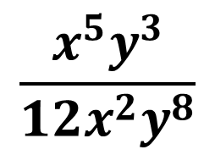
4. Multiply or divide each variable piece by correctly applying exponent rules.
If two variables with the same base are multiplying each other, you can add the exponents.
If two variables with the same base are dividing each other, you can subtract the exponents.
$$\frac{x^{5}y^{3}}{12x^{2}y^{8}}$$
x³
$$12$$
y²

