Slide 1
Algebra 1
Concepts, Topics, and Skills

Slide 2
What am I being asked to do?
Click the appropriate box.
Solve something
Simplify something
Factor something
Find
slope
Graph something
Find something
Write/translate something
Decide
something
Add/Subtract/Multiply/Divide something
Something with Triangles
Something with functions
Find area/
Volume/
Surface area

Slide 3
Solve what…?
Click the appropriate box.
Solve an Equation
(Chapter 3)
Solve an Inequality
(Chapter 6)
Solve a Proportion
(Chapter 3)
Solve a Quadratic Equation
(Chapter 9 or 10)
Solve a System of Equations
(Chapter 7)

Slide 4
Simplify what…?
Click the appropriate box.
Simplify using Distributive Property
(Chapter 2)
Simplify Exponents
(Chapter 8)
Simplify Radicals
(Chapter 11)

Slide 5
Graph what…?
Click the appropriate box.
Graph a Linear Equation
(Chapter 4)
Graph a Linear Inequality
(Chapter 6)
Graph a Linear System
(Chapter 7)
Graph a Quadratic Equation
(Chapter 10)
Graph a System of Inequalities
(Chapter 7)

Slide 6
Add, subtract, multiply, divide…?
Click the appropriate box.
Integers
(Chapter 2)
Fractions
(5th and 6th Grade)
Polynomials
(Chapter 9)
Radicals
(Chapter 11)

Slide 7
integers…
Click the appropriate box
Add Integers
(Chapter 2)
Subtract Integers
(Chapter 2)
Mult./Div. Integers
(Chapter 2)

Slide 8
fractions…
Click the appropriate box
Add Fractions
(5th and 6th Grade)
Subtract Fractions
(5th and 6th Grade)
Multiply
Fractions
(5th and 6th Grade)
Divide Fractions
(5th and 6th Grade)

Slide 9
polynomials…
Click the appropriate box
Add Polynomials
(Chapter 9)
Subtract Polynomials
(Chapter 9)
Multiply Polynomials(Chapter 9)

Slide 10
triangles…
Click the appropriate box
Find the missing side of a right triangle
(Chapter 11)
Decide if three side lenghts could form a right triangle
(Chapter 11)
Find a missing angle
(7th Grade)
Find the area
(7th Grade)

Slide 11
Writing what…?
Click the appropriate box
Write equations
(Chapter 1)
Write expressions
(Chapter 1)
Write Inequalities(Chapter 1)
Write linear
equations
(Chapter 5)
Write equations in function form
(Chapter 3)
Write a rule for a function
(Chapter 2)

Slide 12
Solve an equation…
*GOAL* Isolate the variable!
Check to see if the equation is completely simplified…
Can you distribute or combine like terms?
YES
NO

Slide 13
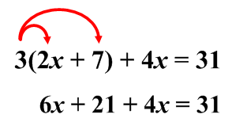
Simplify
1. Distribute if necessary
3(2x + 7) + 4x = 31
2. Combine like terms if possible
NEXT STEP

Slide 14
Begin to isolate…
*Don’t forget that whatever you do to one side, you must do the other!*
Are there variables on both sides of the equation?
YES
NO

Slide 15
Get variables together
Move one of the variable terms to the other side of the equation. Your only options are to add or subtract.
2x – 8 = 4 – 4x
+4x +4x
6x – 8 = 4
NEXT STEP

Slide 16
Continue Isolating…
Is there anything adding or subtracting to/from the variable?
YES
NO

Slide 17
GET RID OF IT!
Use the inverse operation, either addition or subtraction, to cancel out the number that is being added or subtracted. (Make it 0)
Ex: 2x + 3 = 11
–3 – 3
Ex: –4 + 5x = 16
+4 +4
Subtracting 3 cancels out the 3.
(Makes it 0)
Adding 4 cancels out the –4 .
(Makes it 0)
NEXT STEP

Slide 18
Continue Isolating…
Is there anything multiplying or dividing the variable?
YES
NO

Slide 19
GET RID OF IT!
Use the inverse operation, either multiplication or division, to cancel out the number that is multiplying or dividing the variable. (Make it 1)
Ex:
$$2x=4$$
Ex:
$$\frac{x}{3}=4$$
3·
·3
$$2$$
$$2$$
Dividing by 2 cancels out 2. (makes it 1)
Multiplying by 3 cancels out the 3.
(Makes it 1)
NEXT STEP

Slide 20
Your variable should be isolated
IT IS!
YAY!
Umm…the variable is gone…
Ex: x = 3
That’s my answer!

Slide 21
“No Solution” vs. “All Real #’s”
*Remember that your goal is to state what x can be. For example: x = 3 says that x can be 3 and nothing else.
3 = 10 doesn’t say that can be 3 or 10, it just shows you two numbers that aren’t equal. But since it’s a false statement it means that x cannot be anything so we say…
NO SOLUTION!
4=4 doesn’t say that x can equal 4 either. It just shows two numbers that ARE equal. But since it’s a true statement it means that x can be anything so we say…
ALL REAL NUMBERS!

Slide 22
To solve a proportion you cross multiply:
Example:
Example:
3x = 36
2(x + 3) = 36
__ __
3 3
2x + 6 = 36
x = 12
–6 –6
2x = 30
__ __
2 2
x = 15

Slide 23
What with functions…?
Click the appropriate box.
Find domain and range of a function
(Chapter 2)
Rewrite equations in function form
(Chapter 3)
Write a rule for a function
(Chapter 2)
Decide if a relationship is a function
(Chapter 2)

Slide 24
To write an equation in “function form” means to isolate y.
Example:
2x – 4y = 8
–2x –2x
-4y = 8 + -2x
–4 –4
y = –2 + ½ x

Slide 25
How am I presented the info?
I am given two points
I am given a graphed line

Slide 26
Then I would need to use the formula…
RISE
RUN
I forget how to do that…(click here)
NEXT STEP

Slide 27
DON’T FORGET!!!
What do you need to remember if the line looks like this?!
*It’s NEGATIVE*

Slide 28
Then I would need to use the formula…
I forget how to do this…(click here)

Slide 29
To graph a line I can either…
Make a table…
Use x and y intercepts…
Use Slope-Intercept Form

Slide 30
Making a table…
Set up a table and choose 4-5 values for x so I can find y.
*Make sure the equation is written in function form first to be sure to choose the most appropriate/easiest values for x.
Don’t remember which values to pick?
Click here.

Slide 31
Using x and y Intercepts…
This is most effective when the equation is written in standard form. (Ax + By = C)
Find the x-intercept by letting y = 0. Find the y-intercept by letting x = 0. If graphing, graph each intercept separately.
I completely forget how to do that…
(Click here)

Slide 32
Using Slope-Intercept Form
First make sure the equation is written in slope-intercept form.
(y = mx + b)
The first point you can graph is the y-intercept, then move to the next point by going where the slope tells you to go.
Click here if you forget how to do that.

Slide 33
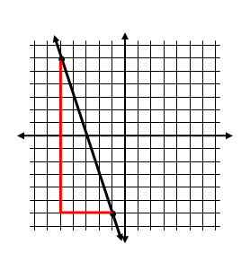
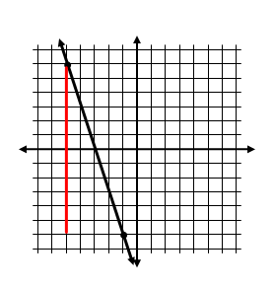
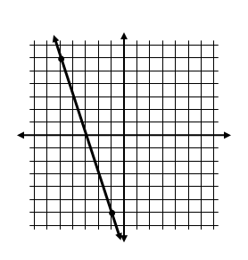
To find slope of a graphed line using rise
run
Find the vertical distance between the two points and the horizontal distance between the two points. Plug into the formula and simplify.
**DON’T FORGET THE FINAL ANSWER IS –3!
Rise = 12
Run = 4

Slide 34
If you are given two ordered pairs:
(x, y) and (x, y)
The first ordered pair is
(x₁, y₁) and the second is (x₂, y₂)
For example:
To find the slope of the line that passes through the
points (3, 1) and (5, 2) you can first label the coordinates.
x₁ y₁
x₂ y₂
*Don’t forget to simplify.
Then plug into the formula:
2 – 1
1
m = =
5 – 3
2

Slide 35
Typically the five easiest values to pick for x are:
–2, –1, 0, 1, 2
You really could choose any five values you want, but these are small and will product points on both sides of the origin.
If after you put the equation in function form and the coefficient of x is a fraction, then you want to choose x values that are multiples of the denominator so you don’t end up with fractions.
$$y=\frac{1}{3}x+2$$
For example, if:
Then it would make the most sense to choose –6, –3, 0, 3, 6

Slide 36
For the equation:
3x – 6y = 18
If you wanted to graph using x and y intercepts, you first would need to figure out what the x and y intercepts are. To find the x-intercept, replace y with 0. Then solve for x. To find the y-intercept do the same thing except replace x with 0 and solve for y.
x-intercept: y-intercept:
3x – 6(0) = 18 3(0) – 6y = 18
3x = 18 –6y = 18
3 3 –6 –6
x = 6 y = –3
This point would be 6 spaces right on the x - axis
This point would be 3 spaces down on the y - axis

Slide 37
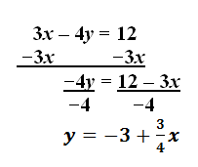
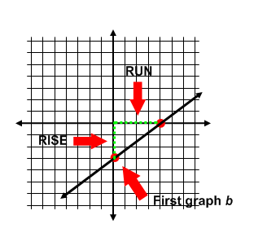
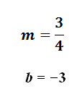
If you need to graph 3x – 4y = 12 using slope-intercept form the first thing you need to do is make sure it is in slope-intercept form. (Isolate y)
Once in slope-intercept form, graph
the y-intercept first (either go up or
down on the y-axis), then move where
the rise and run tell you to go.
= Rise
= Run

Slide 38
What Am I Being Asked to Do?
Write an equation in slope-intercept form (y = mx + b)
Write an equation in standard form
(Ax + By = C)
Write equations of Parallel and Perpendicular Lines

Slide 39
Writing an Equation in Slope-Intercept Form
Do you know the slope?
YES
NO

Slide 40
Do you know the y-intercept?
YES
NO

Slide 41
Plug the slope in for m and the y-intercept for b into
y = mx + b
y = □x + □
m
b

Slide 42
Are you given 2 points or a graph?
2 POINTS
A Graph

Slide 43
Find the slope of the line…
Click here if you don’t remember how to find the slope given two points…
Click if you are ready to move onto the next step.

Slide 44
Find the slope of the line…
Click here if you don’t remember how to find the slope given a graph…
Click if you are ready to move onto the next step.

Slide 45
Maybe you can easily find the y-intercept…
I can see on a graph
exactly where the line
crosses the y-axis
I have a point where the x-coordinate = 0
Neither

Slide 46
To find b, plug m, x and y into y = mx + b
For example, if the slope is 4 and the line passes through the point (2, 1) plug all of this information into y = mx + b then solve for b.
1 = 4(2) + b
1 = 8 + b
–8 –8
–7 = b
Click here for the next step.

Slide 47
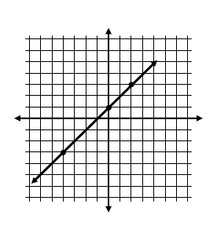
y-intercept!!
Click here for the next step.

Slide 48
*REMEMBER*
The y-intercept is where the line hits the y-axis. If the point is on the y-axis, the x-coordinate has to be 0, so if that happens, the y-coordinate is the y-intercept.
If (0, 2) is the ordered pair…
Then….
(o, 2)
y-intercept
Click here for the next step.

Slide 49
Use this formula…
Ex: (5, 3) (2, 6)
x1 y1 x2 y2
Click here for the next step.

Slide 50
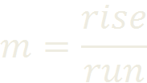
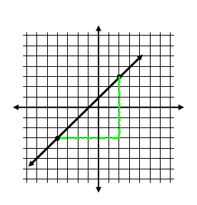
Use this formula…
Click here for the next step.
Rise
Run

Slide 51
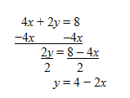
Find the slope FIRST!
1. Use the given equation to find the slope (**REMEMBER that do to this the equation needs to be written in slope-intercept form…which means y needs to be isolated**)
2. Identify the slope.
Slope = –2
If y = 2x + 3 then the slope is 2.
For Perpendicular
Click here
For Parallel
Click here

Slide 52
PARALLEL!
Use the exact same slope as the given line (since parallel lines have the same slope) and then also plug in x and y which you get from the given ordered pair.
Solve for b.
Plug in m and b into y = mx + b when done.
See an Example

Slide 53
PERPENDICULAR!
When plugging in the slope be sure to use the OPPOSITE RECIPROCAL of the slope of the original equation.
Plug in x and y from the ordered pair.
Solve for b.
Plug in m and b into y = mx + b. (Be sure to use the CORRECT slope!
See an Example

Slide 54
Parallel example…
A line passes through the point (–3, 2) and is parallel to 5x + y = 6.
· Rewrite the equation of the line so it is in slope-intercept form. (Subtract 5x from both sides to do this)
y = 6 – 5x
· Identify the slope (The slope is –5)
· Plug in the slope and x and y into y = mx + b and solve for b.
2 = –5(–3) + b
2 = 15 + b
–13 = b
· Plug m and b into y = mx + b y = –5x + –13

Slide 55
Perpendicular example…
Write the equation of the line perpendicular to
y = –½x – 4 and passes through the point (–1, 5).
Since the equation of the first line is already in slope-intercept form, you should be easily able to identify the slope as –½. The line you are trying to write the equation of is perpendicular though, so its slope would be 2 (opposite reciprocal) and also passes through the point (–1, 5). Plug all of this information into y = mx + b then solve for b.
5 = 2(–1) + b
y = 2x + 7
5 = –2 + b
+2 +2
7 = b
Use correct slope!

Slide 56
Standard Form
To write an equation in standard form:
Write the equation in slope-intercept form
Move the x-term to the same side as the y-term (the x-term should come first)
Adjust if necessary so A, B and C are not fractions or decimals and A is positive.
Ex: If m = ¾ and b = ⅝
y = ¾x + ⅝
Put in slope-intercept form
–¾x –¾x
Move the x term over
–¾x + y = ⅝
–8( )
Multiply by 0 – 8 to get rid of both fractions and make A positive
6x – 8y = –5
Final Answer!

Slide 57
Work towards isolating the variable…
Check to see if the inequality is completely simplified…
Can you distribute or combine like terms?
YES
NO

Slide 58
Simplify
1. Distribute if necessary
3(2x + 7) + 4x > 31
>
>
>
2. Combine like terms if possible
NEXT STEP

Slide 59
Begin to isolate… *Don’t forget that whatever you do to one side, you must do the other!
Are there variables on both sides of the equation?
YES
NO

Slide 60
Get variables together
Move one of the variable terms to the other side of the equation. Your only options are to add or subtract.
2x – 8 > 4 – 4x
+4x +4x
6x – 8 > 4
NEXT STEP

Slide 61
Continue Isolating…
Is there anything adding or subtracting to/from the variable?
YES
NO

Slide 62
GET RID OF IT!
Use the inverse operation, either addition or subtraction, to cancel out the number that is being added or subtracted. (Make it 0)
Ex: 2x + 3 > 11
–3 – 3
Ex: –4 + 5x > 16
+4 +4
Subtracting 3 cancels out the 3.
(Makes it 0)
Adding 4 cancels out the –4 .
(Makes it 0)
NEXT STEP

Slide 63
Continue Isolating…
Is there anything multiplying or dividing the variable?
YES
NO

Slide 64
GET RID OF IT!
Use the inverse operation, either multiplication or division, to cancel out the number that is multiplying or dividing the variable. (Make it 1)
Ex:
$$2x>4$$
Ex:
$$\frac{x}{3}>4$$
3·
·3
$$2$$
$$2$$
Dividing by 2 cancels out 2. (makes it 1)
Multiplying by 3 cancels out the 3.
(Makes it 1)
NEXT STEP

Slide 65
Your variable should be isolated
IT IS!
YAY!
Umm…the variable is gone…
Ex: x > 3
That’s my answer!
BTWs…this means that x can be any number that is greater than 3. There are infinite possibilities.

Slide 66
“No Solution” vs. “All Real #’s”
*Remember that your goal is to state what x can be. For example:
x > 3 says that x can be any number that is bigger than 3. For example: 3.1, 4, 5, or even 100,000.
3 > 10 doesn’t say that x can be 3 or 10, it just says “3 is greater than 10,” which is FALSE. Since it’s a false statement it means that x cannot be anything so we say…
NO SOLUTION!
4 < 8 doesn’t compare x to 4 or 8. It just says “4 is less than or equal to 8,” which is TRUE! Since it’s a true statement it means that x can be anything so we say…
ALL REAL NUMBERS!

Slide 67
*NEW RULE ALERT*
Did you MULTIPLY or DIVIDE by a NEGATIVE to finish isolating x?
Yes
No

Slide 68
Then you must reverse the inequality sign!
x
<
3
>
NEXT STEP

Slide 69
What am I being asked to do?
Solve the system of equations by graphing
Solve the system of equations by substitution
Solve the system of equations by elimination

Slide 70
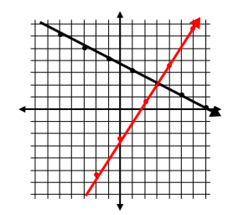
Solve a system by graphing
Graph each line separately in the same coordinate plane.
Look for the point of intersection. (this is your solution)
I got parallel lines
I forget how to graph lines….
(Click here)
I got one line
Solution is (3, 2)

Slide 71
Solve a system by substitution
Isolate one of your variables
Substitute what that variable is equal to into the other equation
Solve for the variable you have
Find the other variable….
Express your answer as an ordered pair.
y =
2x – 5
3x + 2y = 5
True Statement
False
Statement
3x + 2(2x – 5) =5
Now solve for x, then go back and find y.

Slide 72
Solve a system by elimination
Make sure the equations are ready to be added or subtracted (you may have to rearrange your equations so they are stacked, you may also have to multiply one or both equations so the coefficients of one of the variables match)
Add or subtract your equations so one of your variables gets eliminated.
Solve for the single variable you have left.
Plug back into either equation to find the other variable.
Express your answer as an ordered pair.
3x – 4y = 8
6x + 4y = 10
+
_____________
True Statement
False
Statement
9x = 18
__ __
9 9
x = 2
Now find y…

Slide 73
Graphing lines review….
To graph a line you can either use:
A TABLE (this is going to take a while because you’re going to have choose 5 values for x…after you have rewritten the equation in function form)
X AND Y INTERCEPTS (this can be pretty quick, especially if the equation is written in standard form (Ax + By = C)….all you have to do is replace x with 0 to find the y-intercept and replace y with 0 to find the x-intercept.)
SLOPE-INTERCEPT FORM (most people like this one the best….you need to make sure the equation is written in slope-intercept form first, which means y is isolated, graph the y-intercept first, then go where the slope tells you to go.)
See example
See example
NEXT STEP

Slide 74
Don’t forget…
Your final answer is an ordered pair…
which looks like:
(x, y)
You need both x and y!

Slide 75
Infinite soLUtions
Since the solution to a linear systems is where the two lines intersect, then there would be infinite solutions if you get the same line, because they have infinite points of intersection.
This can also happen when solving by substitution or elimination and you get a true statement (0 = 0). This would also mean infinite solutions since the two numbers are equal.
You cannot say “all real numbers” since not every ordered pair on the coordinate plane would work.

Slide 76
No solution
Since the solution to a linear system is where the lines intersect, if the lines are parallel, then there is no solution, because they never intersect.
This can also happen when solving by substitution or elimination and you get a false statement (0 = 7). This would also mean no solution since the two numbers are not equal.

Slide 77
For the equation:
3x – 6y = 18
If you wanted to graph using x and y intercepts, you first would need to figure out what the x and y intercepts are. To find the x-intercept, replace y with 0. Then solve for x. To find the y-intercept do the same thing except replace x with 0 and solve for y.
x-intercept: y-intercept:
3x – 6(0) = 18 3(0) – 6y = 18
3x = 18 –6y = 18
3 3 –6 –6
x = 6 y = –3
This point would be 6 spaces right on the x - axis
This point would be 3 spaces down on the y - axis
NEXT STEP

Slide 78
If you need to graph 3x – 4y = 12 using slope-intercept form the first thing you need to do is make sure it is in slope-intercept form. (Isolate y)
Once in slope-intercept form, graph
the y-intercept first (either go up or
down on the y-axis), then move where
the rise and run tell you to go.
= Rise
= Run
NEXT STEP

Slide 79
Decide what…?
Is an equation
Direct Variation?
Is a relationship a function?
Parallel
lines?
Perpendicular
lines?
Is a # a solution to an equation or inequality?
Is an ordered pair a solution to a linear equation or inequality?

Slide 80
What type of problem do you have?
I need to simplify
There is a radical in the denominator
There is a fraction under the radical
I need to perform operations (Such as adding, multiplying, distributing, FOIL-ing

Slide 81
Simplify a Radical
*Remember that in order for a radical to be in simplest form it cannot have any perfect square factors. This means that numbers like 4, 9, 16, 25…etc, cannot divide a number under a radical sign.
1) Look for the biggest perfect square that will divide the number inside.
$$\sqrt{48}$$
2) Split the number into the product of the perfect square and the other number
$$\sqrt{16}\sqrt{3}$$
3) Take the square root of the one you can. Leave the other number inside.
$$4\sqrt{3}$$
I still need to rationalize the denominator

Slide 82
Split using division property
1) If there is a fraction inside the radical, the division property says you can split and give each piece its own radical sign. Simplify any raidcals possible.
$$\sqrt{\frac{24}{7}}$$
$$=\frac{\sqrt{24}}{\sqrt{7}}$$
I still need to rationalize the denominator
I forget how to simplify

Slide 83
Rationalize the Denominator
*Remember that you cannot have a radical in the denominator. This would be an irrational number and your job is to rationalize it by getting rid of the radical in the denominator.
To undo something being square-rooted, the inverse operation is to square it (which means to multiply it by its exact self)
$$·\frac{\sqrt{2}}{\sqrt{2}}$$
So in this example, to get rid of $\sqrt{2}$ in the denominator, multiply it by itself ($\sqrt{2}$). Don’t forget that whatever you to do to the bottom, you do to the top!
$$\frac{2}{\sqrt{2}}$$
$$=\frac{2\sqrt{2}}{2}$$
$$=\sqrt{2}$$
Since the two green 2’s are both outside the radical, they can be simplified.
I still need to simplify a radical

Slide 84
Operations with Radicals
I am adding/
subtracting
I am multiplying/
distributing
I am
FOIL-ing

Slide 85
Adding or Subtracting Radicals
*Remember that in order to add or subtract radicals they must first be like terms. In order for this to occur, the number under the radical must be the same!
Like terms:
Not like terms:
$$2\sqrt{5}+3\sqrt{5}$$
$$4\sqrt{3}−3\sqrt{2}$$
*To add or subtract like radical terms, add or subtract the coefficients, keep the radical the same:
$$2\sqrt{5}+3\sqrt{5}$$
$$=5\sqrt{5}$$
I still need to simplify a radical

Slide 86
Multiplying/Distributing Radicals
*When multiplying radicals, if there are two numbers outside the radical sign, you can multiply and any numbers inside the radical sign can be multiplied. Once complete, check to see if you can simplify.
$$4\sqrt{5}·2\sqrt{12}$$
= $8\sqrt{60}$
I still need to simplify.
*When distributing a radical, apply the distributive property and then follow the multiplication rules shown above. Once complete, check for like terms or radicals that can be simplified.
$$2\sqrt{5}\left(3\sqrt{2}+4\sqrt{10}\right)$$
$$=6\sqrt{10}+8\sqrt{50}$$
I still need to simplify a radical

Slide 87
FOIL-ing Radicals
*FOIL is just distributing twice! It means:
F – First (which terms come first in each parenthesis)
O – Outer (which terms are on the outer edges)
I – Inner (which terms are inner-most)
L – Last (which terms come last in each parenthesis)
$$(5\sqrt{3}+2\sqrt{5})\left(3\sqrt{2}+4\sqrt{10}\right)$$
$$15\sqrt{6}$$
$$+20\sqrt{30}$$
$$+6\sqrt{10}$$
$$+8\sqrt{50}$$
Check to see if you can combine any like terms
I still need to simplify a radical

Slide 88
Adding Integers
Do you numbers have the same sign or different signs?
Same Signs
Different Signs

Slide 89
Same Signs
Keep the sign
Add the numbers
Ex: –4 + (–8) = –12

Slide 90
Different Signs
Keep the sign of the number with the bigger absolute value
Subtract like normal
Ex: 7 + (–15) = –8

Slide 91
Subtracting Integers
Change the subtraction to addition
Change the second number to its opposite
Now click here to follow the addition rules
Ex: 4 – 9
Ex: 3 – (–4)
4 + (–9)
3 + (+4)

Slide 92
Multiplying/DIVIDING Integers
Same signs = positive answer
Different signs = negative answer
Also, if all your are doing is multiplying and there is an even number of negative signs, your answer will be positive. If there is an odd number of negative signs your answer will be negative.

Slide 93
IS THERE A GCF?
(Greatest Common Factor)
*Look at the all of the terms in the polynomial…will anything divide each of them evenly?.
YES
NO

Slide 94
Factor using the GCF
Factor (undistribute) the GCF. *Don’t forget that you can check your answer by distributing…
Ex: 4x² + 20x + 24
4(x² + 5x + 6)
NEXT STEP

Slide 95
What type of polynomial?
Trinomial in the form:
x² + bx + c
Coefficient of x² is 1.
Trinomial in the form:
ax² + bx + c
Coefficient of x² is not 1.
Difference of two squares:
a² – b²
Four-term
polynomial
Finished Factoring: Continue Solving

Slide 96
To factor:
*Recall that difference of two squares:
a² – b²
Factors into:
(a + b)(a – b)
Ex: 9x² – 49
(3x + 7)(3x – 7)
Finished Factoring: Continue Solving
FINAL CHECK

Slide 97
To factor:
*When the coefficient of x² is 1…
All you have to do is find the factors of c that also add up to b! Plug them into the blank spaces.
(x + __)(x + __)
Ex: x² – 7x + 12
(x – 3)(x – 4)
*The factors of 12 whose sum is –7 are –3 and –4!
CHECK YOUR ANSWER BY FOILING!
Finished Factoring: Continue Solving
FINAL CHECK

Slide 98
TO FACTOR:
*When the coefficient of x² is not 1
You have to focus on the possible combinations that get what you want when you FOIL.
(__x + __)(__x +__)
1. First figure out what could possibly fill the yellow and blue lines. (These two digits will multiply to get the FIRST term of the trinomial.
2. Then decide what could possibly fill the green and red lines. (These two digits will multiply to get the LAST term of the trinomial.
3. Of these possibilities, you need to place them on the correct lines, understanding that whatever digit goes on the green line will get multiplied by the yellow digit (outer) and whatever digit gets placed on the blue line will get multiplied by the red digit (inner). These two products must add up to the middle term of the trinomial.
Finished Factoring: Continue Solving
SEE EXAMPLE
FINAL CHECK

Slide 99
Factoring example
Factor the trinomial:
2x² + 7x + 3
*First you can decide what your
parenthesis must open with:
(2x )(x )
2x and 1x are the only digits that will multiply to get 2x²
1 3
*Next figure out the two digits that you
begin to place in the blank spaces:
(2x + 1)(x + 3)
1 and 3 are the digits needed to multiply to get 3
*Remember that placement matters…what digit do you want to get multiplied by 2 and what do you want to get multiplied by 1?
Finished Factoring: Continue Solving
Check that outer and inner add up to the middle term
FINAL CHECK

Slide 100
Solving by factoring…
Is the polynomial already factored for you?
NO
YES

Slide 101
Find the “Roots”
Find out what the variable could be so that the whole equation equals zero…
Ex: If (x + 3)(2x – 1) = 0
What would x be so that if you plugged it in, the equation would equal 0? (There are 2 possibilities)
The 2nd happens if you can get 2x – 1 to equal 0. So figure out what x would need to be to make this happen…
2x – 1= 0 Solve by adding 1 and dividing by 2 on both sides.
x = ½
The 1st happens if you can get x + 3 to equal 0. So figure out what x would need to be to make this happen…
x + 3 = 0 Solve by subtracting 3 from both sides.
x = 3

Slide 102
Setting up your equation
Before solving, you have to make sure your equation has been completely simplified and equals 0.
Once the equation equals 0 you can factor it.
*Help me Factor*
*Ready to Solve*

Slide 103
You SHOULD be done!
· You should have factored your polynomial complete at this point which means…
NOTHING in the parenthesis can be divided by the same number (There is NO GCF)
Trinomials have been factored into the product of two binomials
Difference of two squares have been factored if present.
Finished Factoring: Continue Solving

Slide 104
A trinomial in the form…
*RECALL THAT QUADRATICS COME IN THE FORM:
y = ax² + bx + c where:
a is always the coefficient of x², b is always the coefficient of x and c is always the constant.
Which form is your trinomial in?
a = 1
a ≠ 1

Slide 105
factor by grouping
The only way to factor a four-term polynomial is by grouping…
1. *Create two groups using parenthesis!
( ) ( )
3x³ + 6x² + 4x + 8
2. Factor out the GCF of each set of parenthesis separately.
Finished Factoring: Continue Solving
NEEDS TO BE A PLUS!!
3x²
(x + 2)
+
4
(x + 2)
3. Factor out the binomial in common.
I still need to factor the difference of two squares
(x + 2)
(3x² + 4)

Slide 106
Solve by what method…?
Factoring
Graphing
Square Roots
Quadratic Formula

Slide 107
1. Are there any parentheses?
Ex: (2x²y)³
YES
NO

Slide 108
Get rid of parenthesis by raising each piece to the power
(2x²y)³
2
x²
y
³
³
³
8x⁶y³
NEXT STEP

Slide 109
Are there any negative exponents?
YES
NO

Slide 110
2. Make any negative exponents positive.
If there are negative exponents, make the exponents positive by moving the item.
If the item is in the numerator, move it to the denominator to make it’s exponent positive.
If the item is in the denominator, move it to the numerator to make it’s exponent positive.
$$\frac{4 y}{3 }$$
$$x^{−3}$$
z³
$$z^{−3}$$
x³
NEXT STEP

Slide 111
3. Simplify numbers by multiplying or reducing.
If any of the pieces have numbers for their base, simplify these numbers by either doing out the power, multiplying, reducing or all.
$$\frac{2^{2}x^{5}y^{3}}{4^{2}x^{2}y^{8}·3}$$
1
4
$$x^{5}y^{3}$$
16
12
·3
48
$$x^{2}y^{8}$$
NEXT STEP

Slide 112
4. Multiply or divide each variable piece by correctly applying exponent rules.
If two variables with the same base are multiplying each other, you can add the exponents.
If two variables with the same base are dividing each other, you can subtract the exponents.
$$\frac{x^{5}y^{3}}{12x^{2}y^{8}}$$
x³
$$12$$
y²

Slide 113
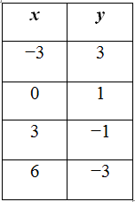
How to write a rule for a function…
*START WITH y = **
Find ∆y and ∆x.
(∆ means “change” – you are finding out how much x and y change by each time.)
Set up a fraction
$$\frac{∆y}{∆x}$$
∆y = –2
∆x = 3
–2
3
Reduce if possible.
3) This number becomes the coefficient of x
y = $−\frac{2}{3}x$
+ 1
4) Adjust if needed by adding or subtracting.
5) Check that it works for each input and output.

Slide 114
Fractions…
Adding/Subtracting
Fractions
Multiplying
Fractions
Dividing
Fractions

Slide 115
Adding and subtracting fractions
Do you have a common denominator?
YES
NO

Slide 116
Find a common denominator
Find the lowest common denominator by finding the lowest number you can change each denominator into by multiplication.
Ex:
Ex:
$$\frac{1}{3} + \frac{2}{5}$$
$$\frac{·5}{·5}$$
$$\frac{·3}{·3}$$
$$\frac{·3}{·3}$$
$$\frac{1}{2} + \frac{1}{6}$$
$$\frac{5}{15}+\frac{6}{15}$$
$$\frac{3}{6}+\frac{1}{6}$$
NEXT STEP

Slide 117
Adding and subtracting fractions
Add (or subtract) the numerators
Keep the denominator
$$\frac{3}{6}+\frac{1}{6}=\frac{4}{6}$$
÷ 2
$$=\frac{2}{3}$$
÷ 2
3) Reduce if possible

Slide 118
Multiply fractions
1) Change any mixed numbers to improper fractions.
1
3
$$4\frac{1}{3}·\frac{9}{13}$$
$$=\frac{13}{3}·\frac{9}{13}$$
+
=$\frac{3}{1}$
x
$$=3$$
1
1
2) Cross cancel if possible.
3) Multiply straight across.
4) Reduce if possible.

Slide 119
Divide fractions
1) Change any mixed numbers to improper fractions.
3
1
$$·\frac{9}{13}$$
$$4\frac{1}{3}÷\frac{13}{9}$$
$$=\frac{13}{3}$$
$$÷\frac{13}{9}$$
+
=$\frac{3}{1}$
x
$$=3$$
1
1
2) Flip the second fraction and multiply.
3) Cross cancel if possible.
4) Multiply across.
5) Reduce if possible.

Slide 120
Apply the distributive property
Distributive property implies multiplication.
Multiply every item inside the parenthesis by the item outside.
3x(2x – 7)
6x²
– 21x
*HELPFUL HINT*
When distributing a negative it can be helpful to rewrite subtracting as adding a negative!

Slide 121
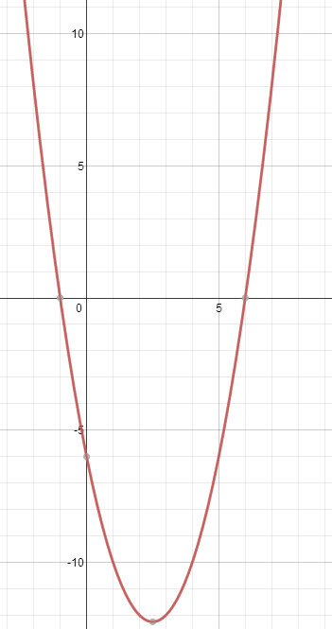
Solve a quadratic by graphing
1) Graph the quadratic equation (either use a graphing calculator or find the axis of symmetry, vertex, and then build around it) *Don’t forget to make it equal 0 before beginning!
y = x² - 5x + 6
2) Identify the “roots” or solutions by finding the values of x where y = 0.
This means find the x-intercepts since this is where on a graph y = 0.
x = 6
x = –1
3) Identify the solutions as x = #
*Its possible to find have one solution, two solutions or no solutions depending on the parabola.

Slide 122
Solve a quadratic by square roots
*If the quadratic is the form: y = ax² + c, then it can be solved by the square roots method. (*b = 0, if not, you can’t use square roots choose another method!
1) Isolate x²
2) · If x² > 0
· If x² < 0
· If x² = 0
There will be 2 answers. A positive and negative.
There will be no solutions because you cannot take the square root of a negative number
There will be one solution (which is 0)
Ex: 0 = 3x² –75
+75 +75
75 = 3x²
3 3
$$√$$
$$√$$
25 = x²
$$±5=x$$

Slide 123
Solve a quadratic using the quadratic formula…
Make sure the quadratic equation equals 0 and is in written in standard form.
Identify a, b, and c.
Plug into the formula and solve.
$$x=\frac{−b±\sqrt{b^{2}−4ac}}{2a}$$

Slide 124
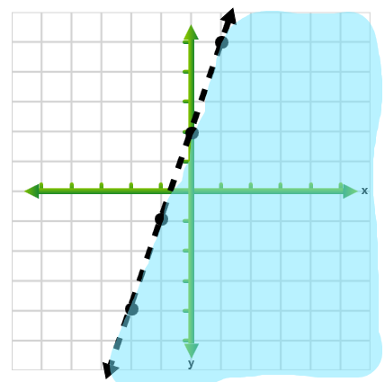
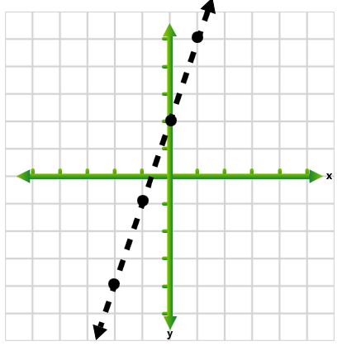
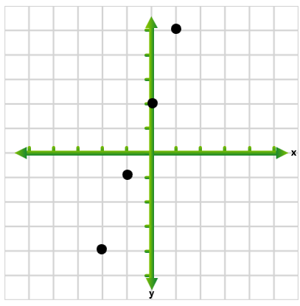
Graph linear inequalities
1) Graph as if it were a regular equation
(Can either use a table, slope-intercept form or
x and y intercepts)
$$y<3x+2$$
0 < 2
Since this inequality is already in slope-intercept
form it would make the most sense to use y = mx + b
Choose a solid or dotted line to connect your points based on the type of inequality.
> or < means a dotted line. > or < means a solid line
Test point (0, 0)
0
0
3) Choose a test point (the origin if possible) and see if it works when you plug it into the original inequality!
If the test point works, shade with it. If not, shade the other side.
Solutions are always located in the shaded region and on the line only if the line is solid!

Slide 125
Write expressions
1. Identify key words and change them to mathematical symbols.
2. If you see a second key word or phrase, use parenthesis!
Click the word below that appears in the sentence:
Quotient
each
per
twice
Sum
Less than
Total
increased
of
into
half
More than
Product
Difference

Slide 126
add

Slide 127
multiply

Slide 128
multiply
*BY 2*

Slide 129
subtract

Slide 130
subtract
*IN THE OPPOSITE ORDER*
Ex: 5 less than x
x – 5

Slide 131
divide

Slide 132
divide
*BY 2*

Slide 133
Write equations and inequalities
If the word
IS
appears, then it will either be an equation or an inequality.
IS
IS EQUAL
TO
IS MORE THAN
AT MOST
NO MORE THAN
AT LEAST
IS THE SAME AS
IS LESS THAN
NO LESS THAN
IS LESS THAN (OR EQUAL TO)
IS GREATER THAN (OR EQUAL TO)

Slide 134
EQUALS SIGN
=

Slide 135
LESS THAN SYMBOL
<

Slide 136
GREATER THAN SYMBOL
>

Slide 137
GREATER THAN OR EQUAL TO
>

Slide 138
LESS THAN OR EQUAL TO
<

Slide 139
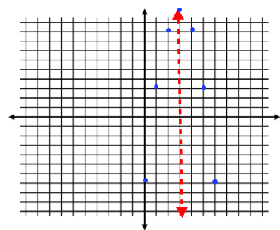
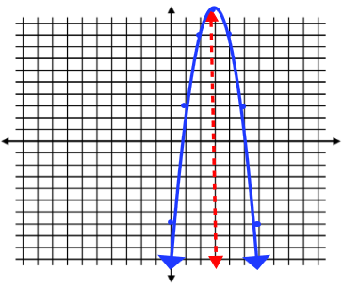
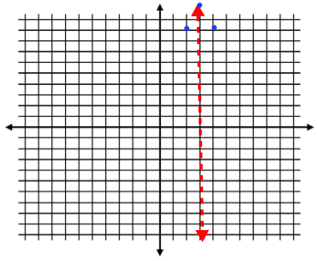
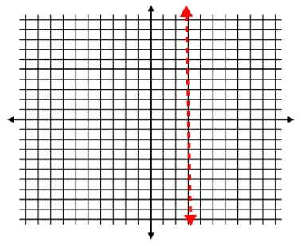
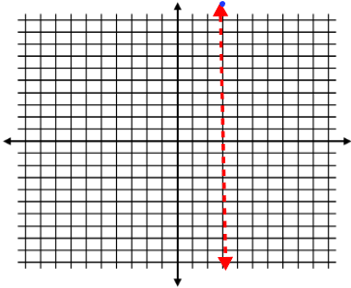
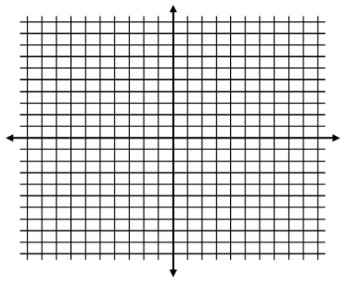
Graph a quadratic equation
*Recall that quadratics are written in the form:
y = ax² + bx + c
1. Find the axis of symmetry using the formula: $x=\frac{−b}{2a}$
Ex: y = –2x² + 12x – 7
x = $\frac{−12}{−4}=3$
2. Use this x-value to find the y-coordinate of the vertex.
Vertex: (3, 11)
3. Since parabolas are symmetrical, you can now build around your axis of symmetry. Choose an x-value on either the left or right side and find the y-value, and the x-value the same distance on the opposite side will have the same y-value. For example, x = 2 and x = 4 will both have the same y-value, because they are the same distance away from the axis of symmetry.

Slide 140
Finding maximums and minimums
*Recall that if a > 0 then it’s a minimum!
if a < 0 then it’s a maximum!

Slide 141
Are these lines parallel?
*RECALL* Parallel lines never intersect! Therefore, they must have the same slope (rate of change)
1. Find the slope of each line by either
a) Writing the equations in slope-intercept form (y = mx + b) and identifying the slope (the coefficient of x) or
b) If the lines are graphed, use rise/run
2. If the slopes are the same, the lines are parallel. If the slopes are different, AT ALL, they are NOT!

Slide 142
Are these lines perpendicular?
*Perpendicular lines have slopes that are opposites and reciprocals! Both must be true to have perpendicular lines!
1. Find the slope of each line by either
a) Writing the equations in slope-intercept form (y = mx + b) and identifying the slope (the coefficient of x) or
b) If the lines are graphed, use rise/run
2. Compare the slopes. If they are opposites and reciprocals, then they are perpendicular. If not both, then they are not.
Ex: If $m=\frac{5}{3} and m=−\frac{3}{5}$ they are perpendicular!

Slide 143
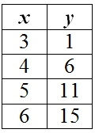
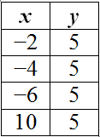
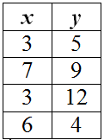
Is it a function?
A FUNCTION is a relationship between input (x) and output (y) where EACH INPUT HAS EXACTLY ONE OUTPUT!
Ex:
Ex:
Ex:
Yes - This is a function because each input has one output.
Yes - This is a function because each input has one output, it does not matter that the output is the same for each…each input has a singular output.
No - This is not a function because the input 3 has two different outputs.

Slide 144
Is a number a solution?
If you are being asked if a number is a solution to an equation or inequality, you are not being asked what type of math sentence. You are being asked a “yes” or “no” question. Is the given number a solution or not. To answer, plug in the number and see if it works.
If it works then…
If it doesn’t work then…
YES, it IS a solution!
NO, it is NOT a solution!
SEE EXAMPLE

Slide 145
Examples of checking for solutions
Is x = 4 a solution to:
2x + 3 = 9
Is y = 5 a solution to:
3x – 4 < 11
2(4) + 3 = 9
8 + 3 = 9
11 = 9
No, it didn’t work,
9 doesn’t equal 11
3(5) – 4 < 11
15 – 4 < 11
11 < 11
Yes, it works, 11 is
less than 11.

Slide 146
Linear equation or inequality?
EQUATION
INEQUALITY

Slide 147
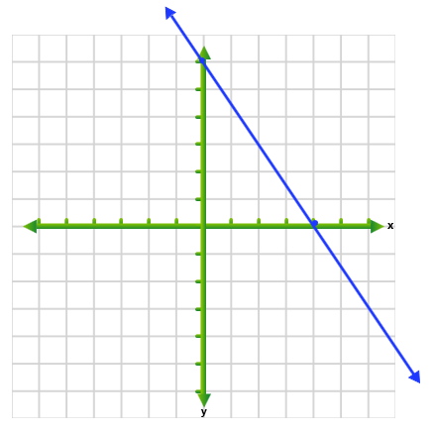
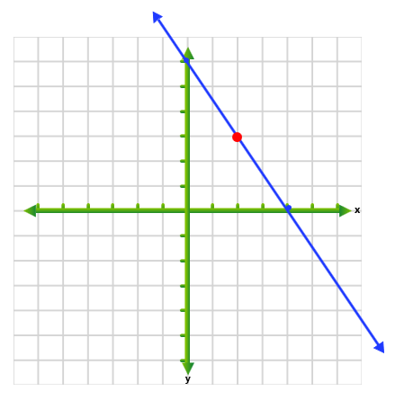
Solutions to linear equations…
1) A solution to a linear equation is any ordered pair (x, y), that when substituted in makes the equation true.
Ex: 3x + 2y = 12
To check if (2, 3) is a solution, replace x with 2 and y with 3.
3(2) + 2(3) = 12
6 + 6 = 12
Since it worked, this means that (2, 3) is a solution.
2) Any ordered pair on the line.
*Keep in mind that any point on the line is a solution,
And since all lines have
Infinite points, linear equations have infinite solutions.
POINT ON THE LINE!

Slide 148
Solutions to linear inequalities…
1) A solution to a linear equation is any ordered pair (x, y), that when substituted in makes the inequality true.
Ex: 3x + 2y < 12
To check if (2, 1) is a solution, replace x with 2 and y with 3.
3(2) + 2(1) < 12
6 + 2 < 12
Since it worked, this means that (2, 3) is a solution.
10 < 12
2) On a graph, this would be any ordered pair in the shaded region or on the line, but only if the line is solid!!
See example of a graph

Slide 149
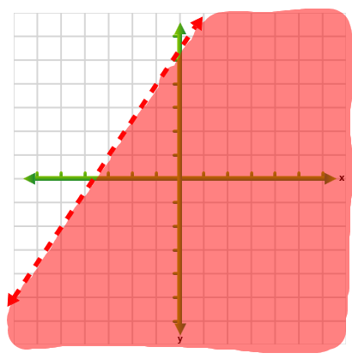
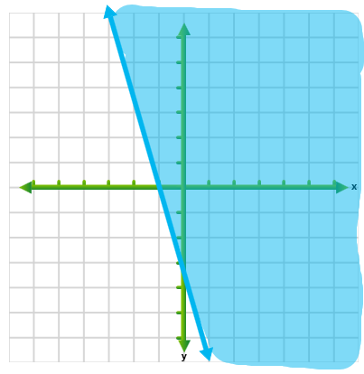
Solutions to linear inequalities…
Ex:
Ex:
In this example, since the line is solid, then the points on the line are also solutions. The line separates the solutions from the other points, but points on the line also count as well.
In this example, since the line is dotted, then the points on the line are not actually solutions. The line simply acts as a border, separating the solutions (in the shaded region) from the other points.

Slide 150
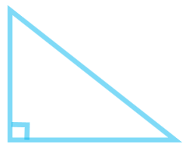
Find the missing side of a right triangle
In order to find the missing side of a right triangle you can use the:
PYTHAGOREAN THEOREM!!
*Remember* a² + b² = c²
a and b are the legs (the two sides that form the right triangle) and c is always the hypotenuse, which is the side opposite the right angle.
Hypotenuse
Leg
See an example of finding a missing leg
See an example of finding the hypotenuse
Leg

Slide 151
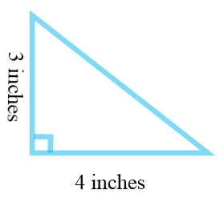
To find the hypotenuse
1) Start by writing down the formula:
2) Plug in the lengths of the legs into a and b.
3) Solve for c.
a² + b² = c²
3² + 4² = c²
9 + 16 = c²
√
25 = c²
√
5 = c

Slide 152
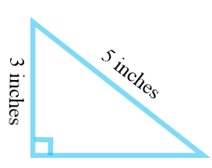
To find the length of a leg
1) Start by writing down the formula:
2) Plug in the length of the leg into a or b, and replace c with the hypotenuse.
a² + b² = c²
3² + b² = 5²
3) Solve for b.
9 + b² = 25
–9 –9
√
b² = 16
√
b = 4

Slide 153
Can 3 sides form a right triangle?
Since the Pythagorean Theorem
a² + b² = c²
Only works for right triangles
Then see if it works.
If it works, then yes, the three sides could form a right triangle.
If not, then no they could no.
*Don’t forget to replace c with the longest side, since if it could form a right triangle, the longest would be the hypotenuse!

Slide 154
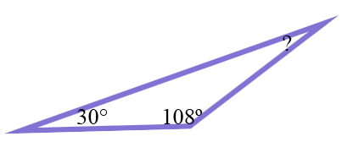
Finding missing angle
The sum of the angles of a triangle are 180°!
Add the angles that you know and subtract this amount from 180.
30 + 108 = 138
180 – 138 = 42°
You can also set up an equation, which can be helpful if you have variables, and then solve.
Ex: 30 + 108 + x = 180

Slide 155
Find the area of a triangle
To find the area of a triangle use the formula:
A = ½ bh
*Don’t forget that base and height always form a right angle!

Slide 156
Geometry formulas
I need a formula for:
Area
SurfaceArea
Volume
Perimeter

Slide 157
Area formulas
Choose your shape
Triangle
Square
Parallelogram
Circle
Trapezoid
Rectangle
Shaded region
Complex Figure

Slide 158
Area of a rectangle
Use the formula:
A = bh or A = lw
UNITS ARE SQUARED!!

Slide 159
Area of a square
Use the formula:
A = s²
UNITS ARE SQUARED!!

Slide 160
Area of a trapezoid
Use the formula:
A = ½h(b₁ + b₂)
b₁ represents one of the base and b₂ represent the other. They both form a right angle with the height!
UNITS ARE SQUARED!!

Slide 161
Area of a parallelogram
Use the formula:
A = bh
The base and height form a right angle with the height!
UNITS ARE SQUARED!!

Slide 162
Area of a circle
Use the formula:
A = $π$r²
*use 3.14 for  and r represents the radius!
UNITS ARE SQUARED!!

Slide 163
Area of a shaded region
Find the area of the entire figure.
Find the area of the non-shaded region.
Subtract
Area Formulas

Slide 164
Area of a complex figure
Break the figure up into shapes that have formulas.
Find the area of each shape
Add the areas together.
Area Formulas

Slide 165
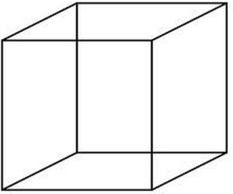
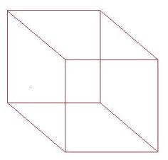
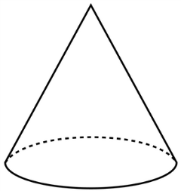
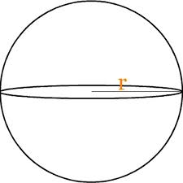
Volume formulas
Choose your three-dimensional figure:
Rectangular
Prism
Cylinder
Cube
Cone
Sphere

Slide 166
Volume of a rectangular prism
Use the formula:
V = lwh
**UNITS ARE CUBED**

Slide 167
Volume of a cube
Use the formula:
V = s³
**UNITS ARE CUBED**

Slide 168
Volume of a sphere
Use the formula:
V = $\frac{4}{3}πr^{3}$
**UNITS ARE CUBED**

Slide 169
Volume of a cylinder
Use the formula:
V = $πr^{2}h$
**UNITS ARE CUBED**

Slide 170
Volume of a cone
Use the formula:
V = $\frac{1}{3}πr^{2}h$
**UNITS ARE CUBED**

Slide 171
perimeter
To find perimeter of any figure, just add up the sides out on the outside!
For circles: Find the circumference using the formula:
C = 2$πr$ or C = $πd$

Slide 172
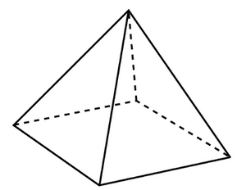
Surface area
Choose your three-dimensional figure:
Rectangular Prism
Cylinder
Cone
Pyramid

Slide 173
Surface area of a cone
Use the formula:
S = πrl + πr²
l = slant height
**UNITS ARE SQUARED**

Slide 174
Surface area of a rectangular prism
Use the formula:
S = 2lw + 2lh + 2wh
**UNITS ARE SQUARED**

Slide 175
Surface area of a pyramid
Use the formula:
area of the base + area of the lateral faces
**UNITS ARE SQUARED**

Slide 176
Surface area of a cylinder
Use the formula:
S = 2πr² + 2πrh
**UNITS ARE SQUARED**

Slide 177
Is it direct variation?
An equation is considered to be direct variation if it can be written in the form:
y = ax
This means that:
The y-intercept must be 0 (therefore the graph will always pass through the origin)
If yes, a is referred to as the constant of variation, but is essentially the slope.

Slide 178
Domain and range
DOMAIN is all of the possible inputs (x) a function can have!
RANGE is all of the possible outputs (y) a function can have!
If a function is not using x and y as its variables, determine which matches up by using the relationship “y depends on x”
When giving domain and range, you want to include all possibilities, showing the minimum and maximum for both the input and output.

Slide 179
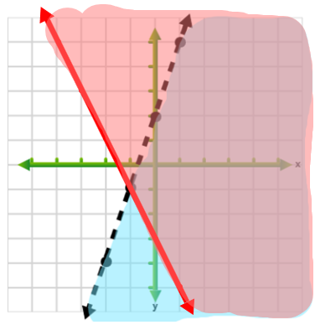
Graph systems linear inequalities
1) Graph the each inequality as if the other did not exist. Be sure to follow the rules for solid/dotted line and where to shade.
Click here to review how to graph an inequality
Inequality 1: $y<3x+2$
Inequality 2 $y≥−2x−3$
2) Solutions are located in the OVERLAPPING SHADED REGION!

Slide 180
Find what?
Max/Min of a
Quadratic Function
“Roots”/Solutions to Quadratic Functions
Degree of a Polynomial
Slope
Domain and Range

Slide 181
Maximum or minimum
*Since the maximum or minimum value occurs at the vertex of the parabola, you need to find the coordinates of the vertex first.
1) Find the axis of symmetry by using the formula: $x=\frac{−b}{2a}$
2) Plug it back in to the quadratic equation to find the y-value of the vertex.
3) The maximum or minimum value is not the entire vertex. It is only the y-coordinate.

Slide 182
Find degree of polynomials
1) Find the degree of each monomial
To do this add the exponents of the variables:
$$Ex: 4x²yz³$$
Degree = 2 + 1 + 3 = 6
2) Choose the degree that is the largest.
Ex: $2x²y²z³ −3xyz$
Deg: 7
Deg: 3
Final Answer!

Slide 183
Adding polynomials
To add polynomials, all you have you to do is combine like terms.
(*Recall that like terms have the exact same variable piece and to add/subtract you simply add/subtract the coefficients. The variable does not change.)
($2x²−3y+2xy)+(3xy−4x^{2}+2y)$
–2x² +
y +
5xy

Slide 184
Subtracting polynomials
To subtract polynomials, change the subtraction between the polynomials to addition.
This changes the sign of every term in the second set of parenthesis!
($2x²−3y+2xy)−(3xy−4x^{2}+2y)$
NOW FOLLOW ADDITION RULES

Slide 185
Multiplying polynomials
*Be sure to follow exponent and sign rules when multiplying or distributing. (It can be helpful to rewrite subtraction as adding a negative before beginning.)
F
irst
(x + 3)(x + 6)
O
uter
x² +
6x +
3x +
18
I
nner
L
ast
x² + 9x + 18

